Slide 1
COM24111: Machine Learning Decision Trees
Gavin Brown
www.cs.man.ac.uk/~gbrown

Slide 2
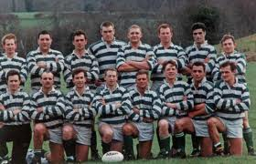
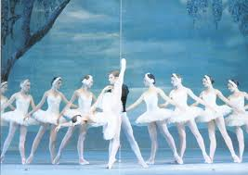
Recap: threshold classifiers
height
weight

Slide 3
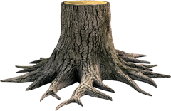
Also known as “decision stump”
1
0
10 20 30 40 50 60
Q. Where is a good threshold?

Slide 4
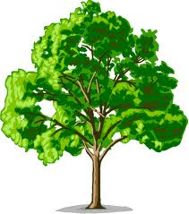
From Decision Stumps, to Decision Trees
New type of non-linear model
Copes naturally with continuous and categorical data
Fast to both train and test (highly parallelizable)
Generates a set of interpretable rules

Slide 5
Recap: Decision Stumps
1
0
10 20 30 40 50 60
predict 0 predict 1
no
yes
10.5
14.1
17.0
21.0
23.2
27.1
30.1
42.0
47.0
57.3
59.9
The stump “splits” the dataset.
Here we have 4 classification errors.

Slide 6
A modified stump
1
0
10 20 30 40 50 60
no
yes
10.5
14.1
17.0
21.0
23.2
27.1
30.1
42.0
47.0
57.3
59.9
Here we have 3 classification errors.

Slide 7
Recursion…
no
yes
10.5
14.1
17.0
21.0
23.2
27.1
30.1
42.0
47.0
57.3
59.9
Just another dataset!
Build a stump!
no
yes
no
yes

Slide 8
Decision Trees = nested rules
10 20 30 40 50 60
no
yes
no
yes
no
yes
if x>25 then
if x>50 then y=0 else y=1; endif
else
if x>16 then y=0 else y=1; endif
endif

Slide 9
Trees build “orthogonal” decision boundaries.
Boundary is piecewise, and at 90 degrees to feature axes.

Slide 10
The most important concept in Machine Learning

Slide 11
The most important concept in Machine Learning
Looks good so far…

Slide 12
The most important concept in Machine Learning
Looks good so far…
Oh no! Mistakes!
What happened?

Slide 13
The most important concept in Machine Learning
Looks good so far…
Oh no! Mistakes!
What happened?
We didn’t have all the data.
We can never assume that we do.
This is called “OVER-FITTING”
to the small dataset.

Slide 14
Number of possible paths down tree tells you the number of rules.
More rules = more complicated.
Could have N rules, where N is the num of examples in training data.
… the more rules… the more chance of OVERFITTING.
no
yes
no
yes
no
yes

Slide 15
Overfitting….
starting to overfit
testing
error
optimal depth about here
1 2 3 4 5 6 7 8 9
tree depth / length of rules

Slide 17
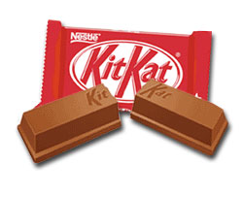
Take a short break.
Talk to your neighbours.
Make sure you understand the recursive algorithm.

Slide 18
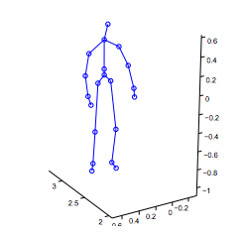
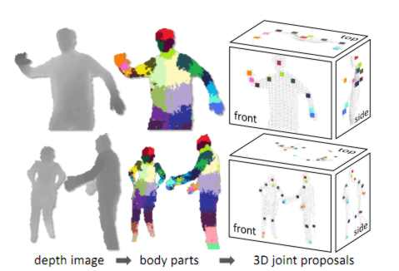
Decision trees can be seen as nested rules.
Nested rules are FAST, and highly parallelizable.
x,y,z-coordinates per joint, ~60 total
x,y,z-velocities per joint, ~60 total
joint angles (~35 total)
joint angular velocities (~35 total)
if x>25 then
if x>50 then y=0 else y=1; endif
else
if x>16 then y=0 else y=1; endif
endif

Slide 19
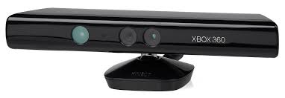
Real-time human pose recognition in parts from single depth images
Computer Vision and Pattern Recognition 2011
Shotton et al, Microsoft Research
Trees are the basis of Kinect controller
Features are simple image properties.
Test phase: 200 frames per sec on GPU
Train phase more complex but still parallel

Slide 20
We’ve been assuming continuous variables!
10
5
5
0
0
0 5 10
10 20 30 40 50 60

Slide 21
The Tennis Problem

Slide 22
Outlook
SUNNY
RAIN
OVERCAST
Humidity
YES
Wind
HIGH
NORMAL
STRONG
WEAK
NO
YES
NO
YES

Slide 24
The Tennis Problem
Note: 9 examples say “YES”, while 5 say “NO”.

Slide 25
Partitioning the data…

Slide 26
Thinking in Probabilities…

Slide 27
The “Information” in a feature
More uncertainty = less information
H(X) = 1

Slide 28
The “Information” in a feature
Less uncertainty = more information
H(X) = 0.72193

Slide 29
Entropy

Slide 30
Calculating Entropy

Slide 31
Information Gain, also known as “Mutual Information”

Slide 32
gain
maximum information gain

Slide 33
Outlook
SUNNY
OVERCAST
RAIN
Temp
Temp
Temp
COOL
MILD
COOL
HOT
MILD
COOL
HOT
MILD
Humidity
YES
Humidity
Humidity
YES
YES
Humidity
Wind
NORMAL
HIGH
WEAK
STRONG
HIGH
NORMAL
HIGH
NORMAL
HIGH
NORMAL
NO
NO
NO
YES
Wind
YES
Wind
Wind
YES
NO
STRONG
STRONG
STRONG
WEAK
WEAK
WEAK
YES
NO
YES
NO
YES
NO

Slide 34
Decision trees
Trees learnt by recursive algorithm, ID3 (but there are many variants of this)
Trees draw a particular type of decision boundary (look it up in these slides!)
Highly efficient, highly parallelizable, lots of possible “splitting” criteria.
Powerful methodology, used in lots of industry applications.

